Slide 1
43 North Association Meeting
December 12, 2023

Slide 2
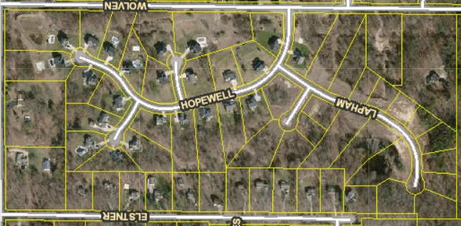

Slide 3
Annual Meeting Agenda
Introductory Information Regarding the Project and the Association
Election of Association Directors
Review of Association’s Records, Bank Account, Insurance
Review Annual Budget
Consideration of Such Other and Further Business as May Come Before the Meeting.

Slide 4
Timeline of Events
Began development construction 2014
Home construction started Fall of 2014
First home closed in Spring 2015
Phase One sold out in 2016
Development was paused until public water was connected by the Township in 2021.
Home Closings:
2015 – 12 Homes
2016 – 12 Homes
2022 – 8 Homes
2023 – 9 Homes (2 remaining homes to close One later in December, and One in April of 2024)

Slide 5
Project and Association Information
43 North Site Condominium Association – Started in 2015
Consists of the original 25 Phase One Units and the additional 18 Phase Two Units for a total of 43 Site Condo Units.
Governed by a Board of Directors
At least three Board Members to fill the role of President, Secretary, and Treasurer.
Condo Associations are governed by a set of documents including a Master Deed and Bylaws which are included in the Purchaser Information Booklet that everyone was to receive and sign upon purchasing a home.

Slide 6
Current Advisory Board members
Therese Gach
Michael Mead
Devon Pearson
Joel Siegel

Slide 7
Election of Association Directors
Kyle Diephuis
Allison Duff
Patty Heffernan
Marisa Hohaia
Jacob Johnson
Brook Russell
Reid Smith

Slide 8
Review of Records and Bank Account
Current process for management:
Manager approves invoices and has JTB pay the invoices and provide bookkeeping without reimbursement or compensation.
Helmholdt and Company currently prepares the annual tax return.
Funds are held at Macatawa Bank in two separate accounts (one for normal operations and one for reserves.)
Current Balance of Operating Account $7,890.28 (projected ending balance approx. $7,000)
Current Balance of Reserve Account $10,000 (Developer is required to ensure that 10% of the current year budget is in place for reserves at time of turn over.)
Upon transition the Association Board will be responsible for providing bookkeeping and invoice payment. At least 2 members of the Board should be added to the checking account or new account set up.

Slide 9
Review of Records
Current Contracts and Providers
Landscaping – 2023 service was contracted through Preferred Landscaping
Snow Plowing – Randy’s Lawn Care contract through April of 2024
Water – Plainfield Township
Electric – Consumers Energy
Insurance policy – Auto Owners Insurance Co. (Tim Koster – Berends Hendricks Stuit)
General Liability (Face Amount $2,000,000)
Dues Records: For 2023 dues have been received from all but one resident (late fees are being charged and may have to escalate to lien on the property)

Slide 10
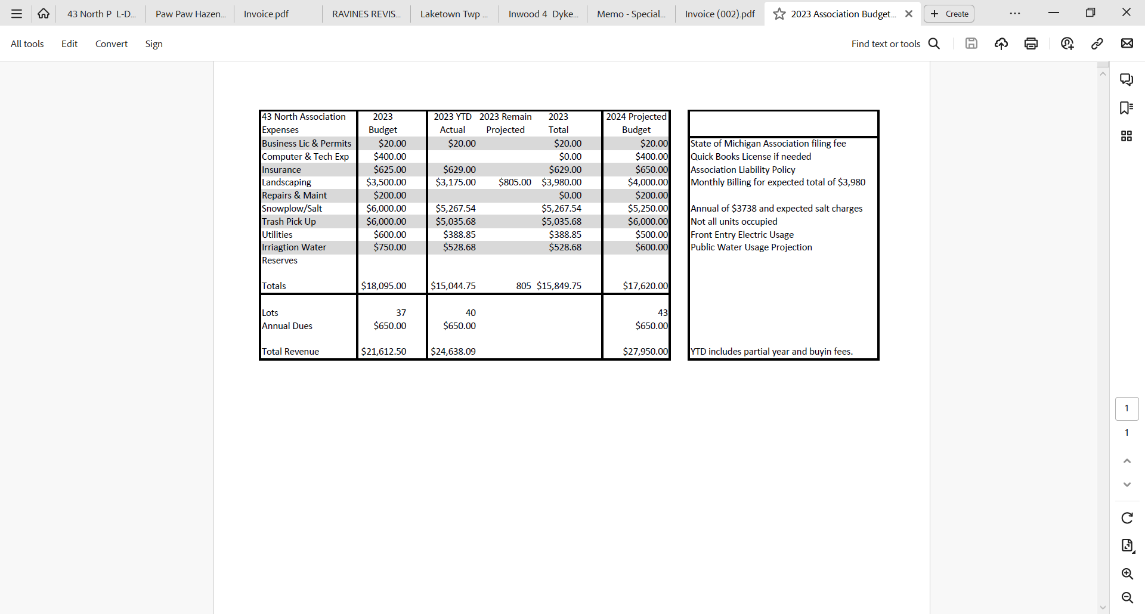
Review of Budget

Slide 11
Q&A
Please let us know what other questions you may have.
Thanks for your time this evening.

